Slide 1
Dynamic Air Technology, Inc.
Manufacturers of custom air-handling equipment
708 N Vincent Ave. Covina, California 91722 • Phone: (626) 967 -7273 • Fax: (626) 967 -7221
General Data

Slide 2
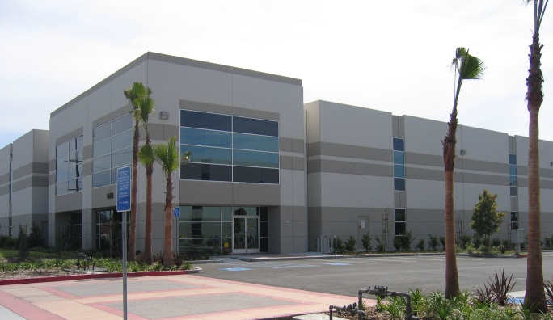
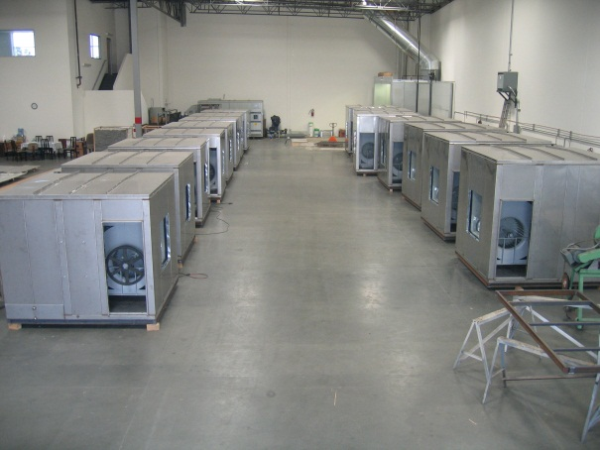
About DAT
Founded in 2002, DAT employs engineers that have over 30 years of experience in the HVAC field.
DAT product line includes air handling units, make-up air units, multi-zone units, energy recovery units, and evaporative cooling units.
DAT strives to work with the customer to fully understand what is needed. Customer satisfaction is always on the top of DAT’s list and will do anything and everything to meet customer needs.
Located just 20 miles east of Los Angeles, DAT is currently located in Pomona, California. Customers are welcome to visit the factory and see how their units are being built.

Slide 3
Custom vs. Standard AHU’s
 | Custom | Standard
Construction | High quality | Low quality for lowest possible cost
Sizes | Custom dimensions to fit in/on any possible situations | Limited sizes to choose from
Configurations | Completely custom; any configurations | Standard & limited
CFM Size | Any size available | Limited CFM sizes
Multi Fan | Several options available | Unavailable or very limited
ECM | EC direct drive plenum fans available | Uncommon
Fan Placement | Placed usually away from openings to control system effects and sound | Placed usually over/under discharge openings to save space
Fan Blades | 12 blade fan selections available | standard 9 blade fans
Bearings | High quality / Low failure rate | Poor quality / High failure rate
Base | Welded structural base | Bolted structural base
Doors | Industrial grade door frames | Poor quality door frames
Door Hinges | Industrial grade door hinges | Cheap commercial hinges
Door Drip Lips | Standard | No drip lips
Dampers | High quality / Sturdy / Resistant | Poor quality / bendable / formed
Damper Size | Sized for actual air flows for best control | Standard damper sizes typically over sized with poor controllability
Actuators | Low torque single damper action requires smaller and fewer actuators | Multiple damper control points with high torque requirements.
Perforated | Full perforated lined sections | Mock perforated noisy sections
Insulation Protection | Solid base or metal liner to protect insulation and floor | Insulation exposed to jobsite conditions (mud, etc.)
Filter Options | Unlimited filter & UV options | Basic filtration options
Drain Pans | Stainless steel drain pans to prevent rust | Galvanized drain pans
Tube coils | Low air pressure drop 1/2" available | 5/8" high APD design
Energy Recovery | Custom & unlimited | Standard & limited
Support | True AHU expertise at rep & factory | Production line mentality

Slide 4
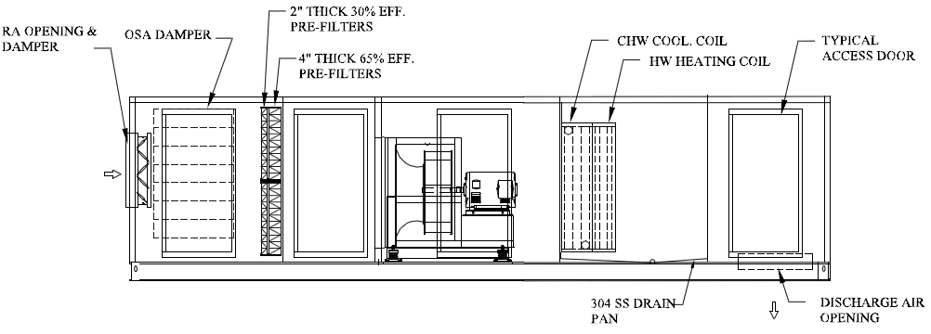
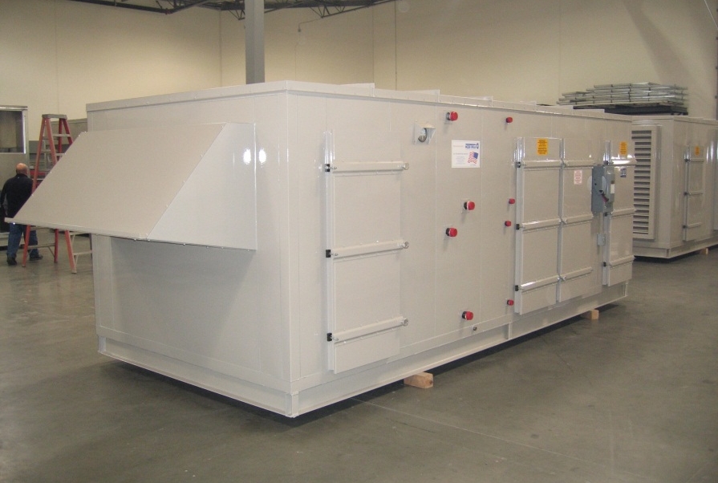
Air Handling unit
DAT’s AHUs range anywhere from 200 CFM to 150,000 CFM
Fully customizable to meet the particular application and specifications such as adding economizer sections, multiple coils, filter efficiency, etc.

Slide 5
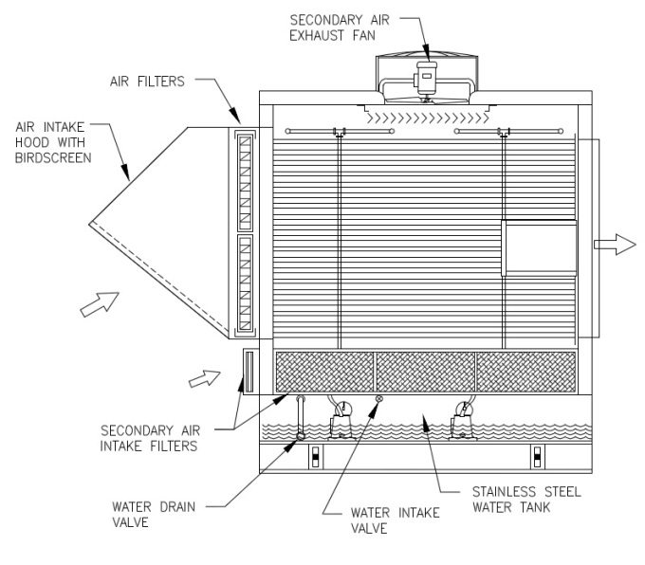
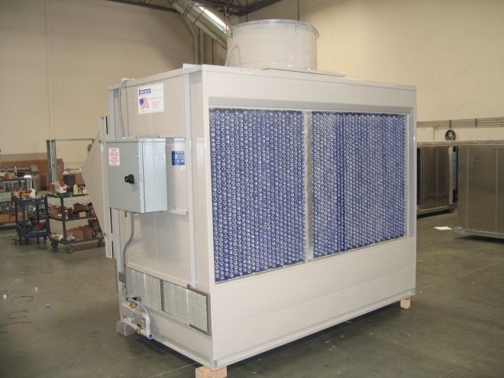
Indirect cooling
DAT’s Indirect section draws air through the PVC tubes while water falls from the top of the tubes to the bottom. During this process, the secondary exhaust fan discharges the internal air outside. This cools the air in the tubes without producing moisture in the supplied air stream.
Notes
DAT uses special PVC tubes which are more resistant to cracking than standard tubes.
Each PVC tube has a “W” shaped aluminum fin inserted to further cool the air and increase resistance to cracking.
DAT’s indirect section is approximately 60% efficient.
The entire indirect section is built out of stainless steel to prevent rusting.
Each tube is 48” long making the indirect section 54” long.
Maximum indirect section is for 30,000 CFM with tube dimensions of 76” H x 160” W.

Slide 6
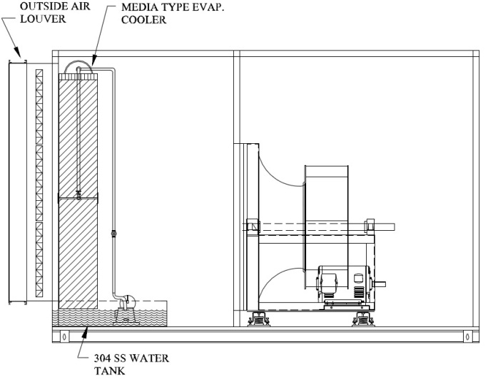
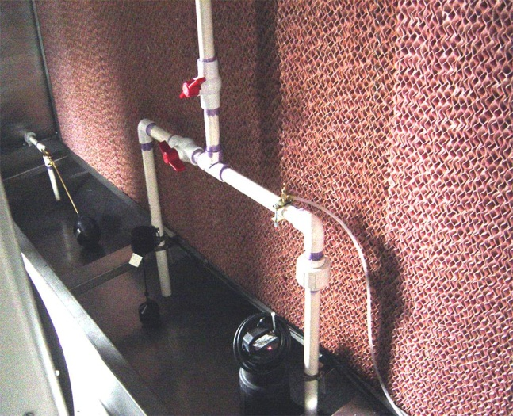
Media evap. cooling
DAT uses 12” deep Munters CELdek® or GLASdek® media. CELdek® is commonly used in cooling only applications while GLASdek® is used in units that have heating applications as well.
Notes
Many accessories are installed as options in MEC units such as low water protection for water pumps, freeze protections, and automatic flush cycle systems.
The entire MEC section is built completely out of stainless steel to prevent rusting.

Slide 7
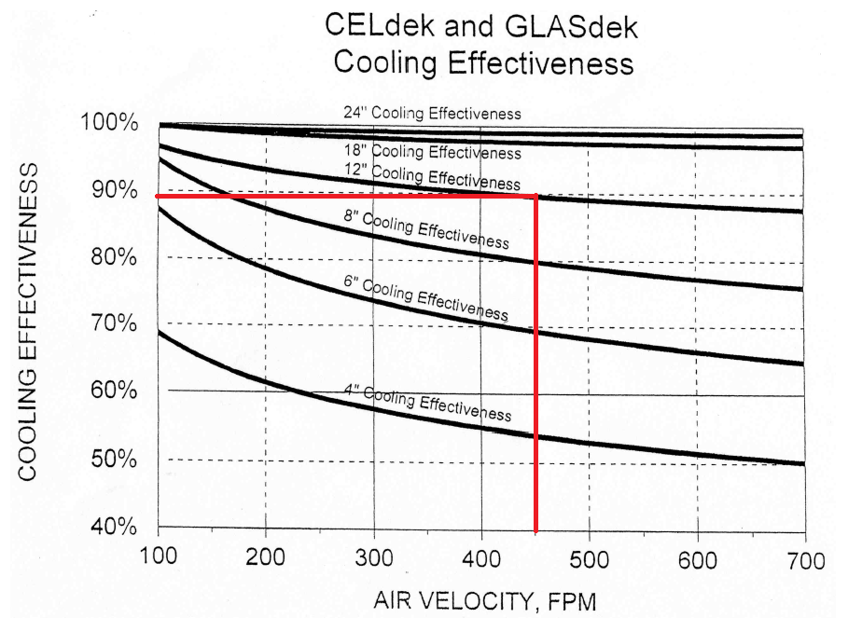
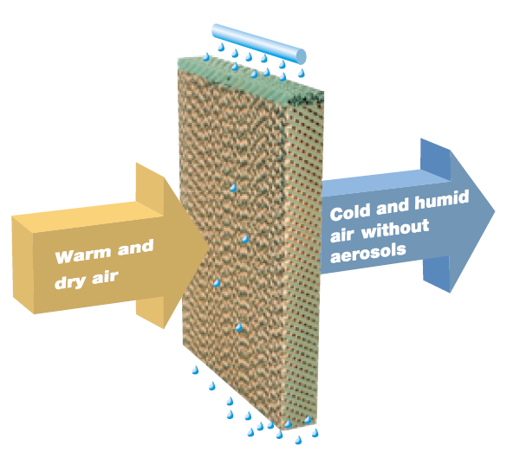
Munters Media Data
DAT uses a standard 12” depth media at 450 FPM giving an approximate efficiency of 88%.
Standard life span is approximately 3-5 years.
Optional edge coating reduces algae build-up, makes for easier cleaning, and extends life expectancy.
Largest direct section is approximately 50,000 CFM with direct section dimensions of 108”H x 156”W.
GLASdek® CELdek® | Standard Sizes
Depth: | 4", 6", 8", 12"
Height: | 48", 60", 72"
Width: | 12"

Slide 8
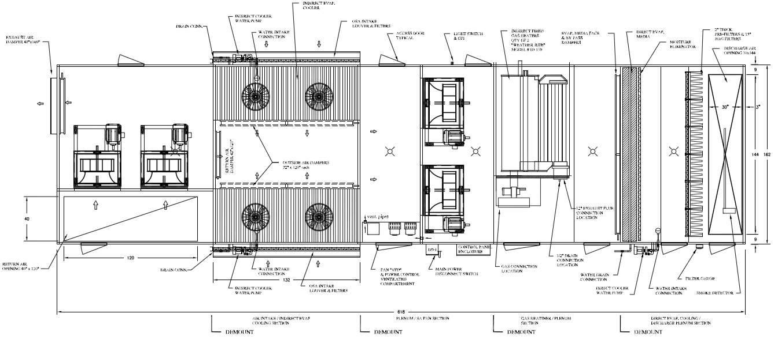
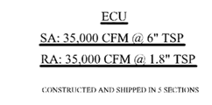
Indirect / direct Units
Some applications have both a indirect and direct section in the same unit. This further cools the outside air with evaporation. The following unit was designed and built for Northrop Grumman.

Slide 9
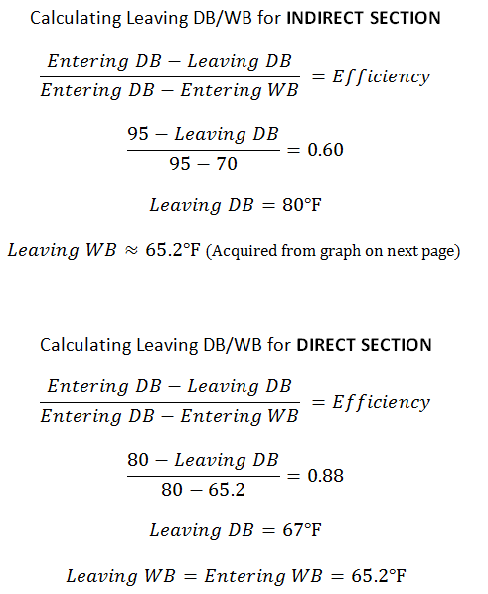
Id/d efficiency calculations
The following shows an example of calculating efficiency of a unit that has both an indirect and a direct section.

Slide 11
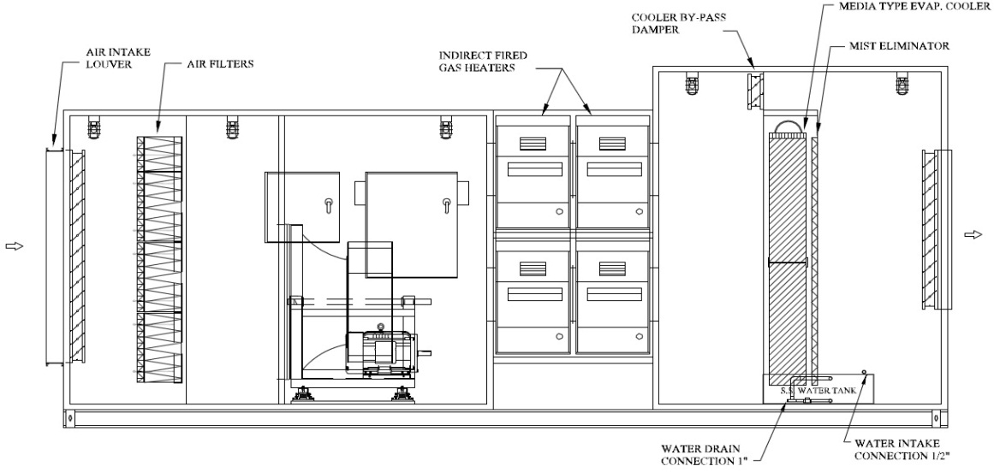
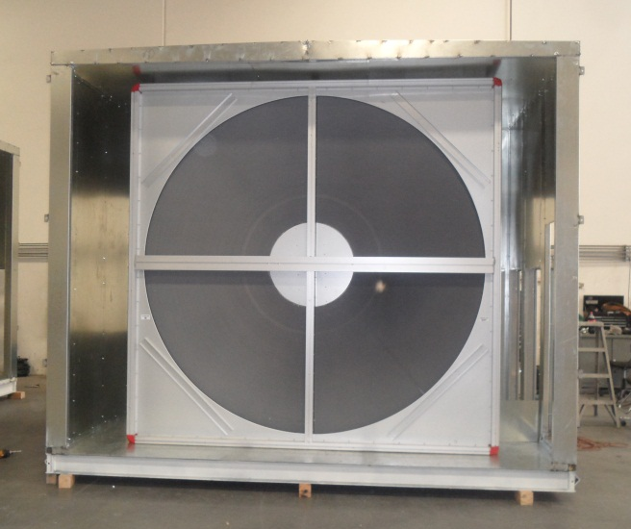
Make-up air unit
MAUs are units meant for cooling, ventilation, and single or multiple stage heating.
Notes
All of DAT’s units are custom built and can have any type of cooling or heating applications in any combination.
Types of heating components can be found in later slides

Slide 12
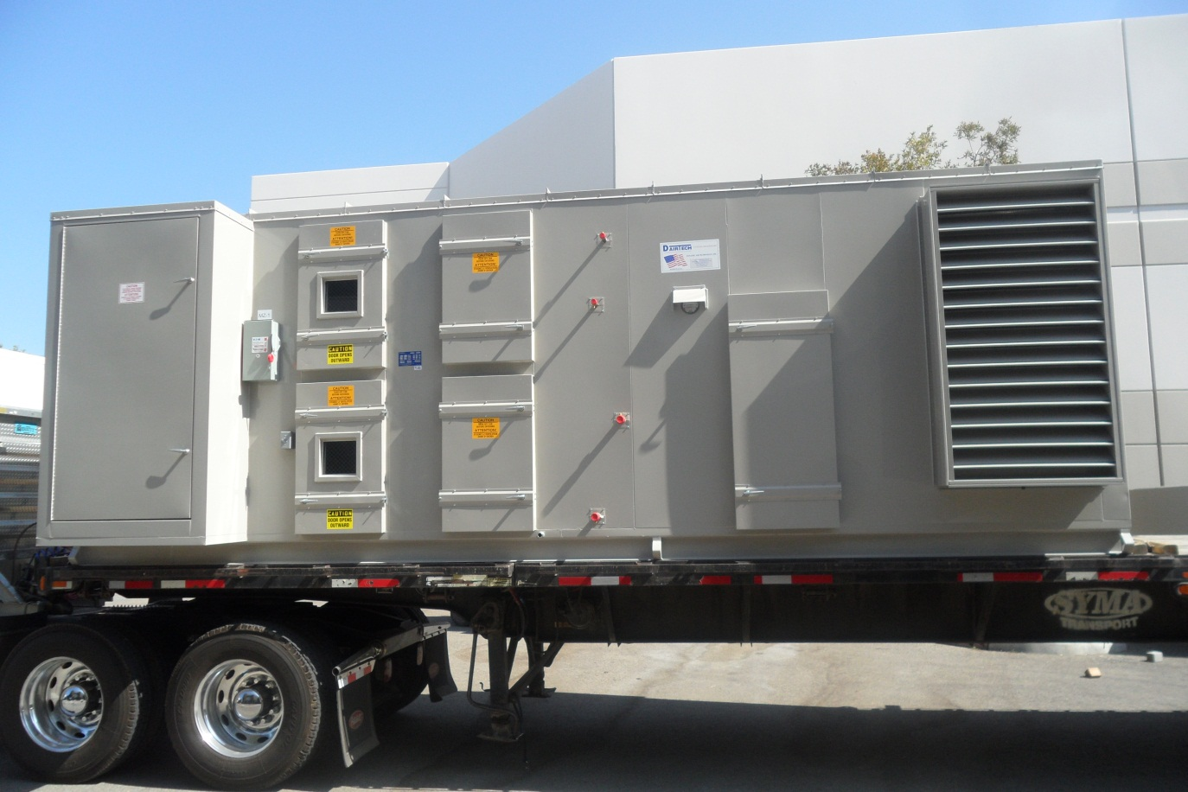
Multi-Zone Unit
Multi-zone units consist of multi-zone dampers which distribute air to several smaller ducts rather than one large duct. The following is a double-deck multi-zone unit built for Cypress College.

Slide 13
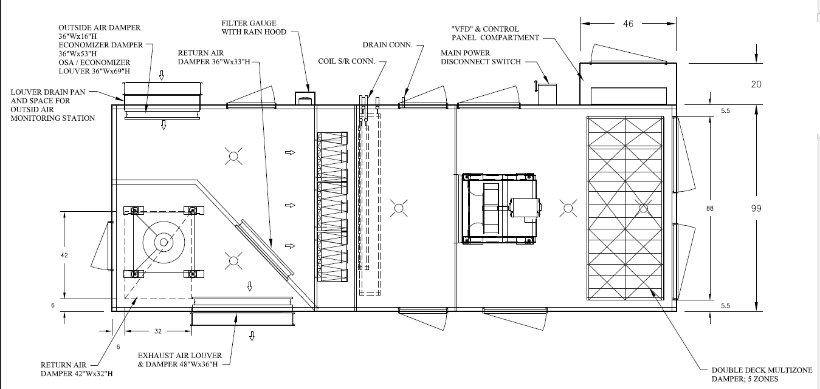
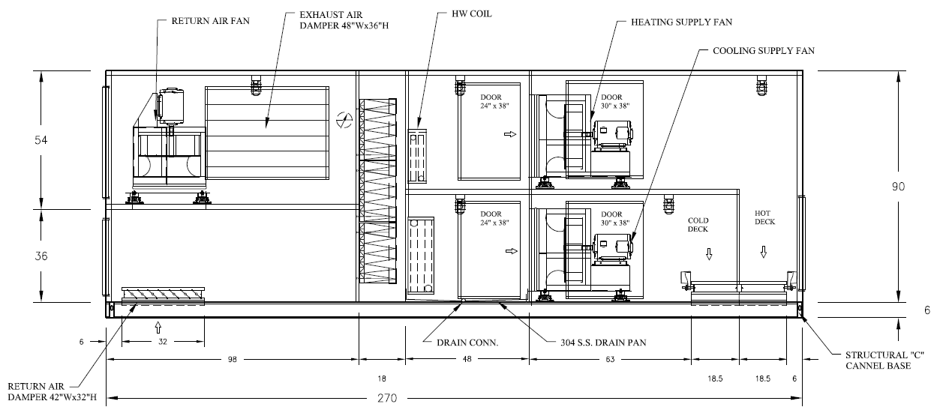
Multi-Zone Unit (drawing)
The following is the AutoCAD drawing of the unit found on the previous slide. The top is a hot deck while the bottom is a cold deck. The hot and cold air then leave through a multi-zone damper.

Slide 14
Fan Coil & Fan Filter Units
DAT offers fan coil units and fan filter units that will satisfy customer needs.
Notes
All types of filters with different efficiencies can be used in these units.
Offered with both AC motors and EC motors.

Slide 15
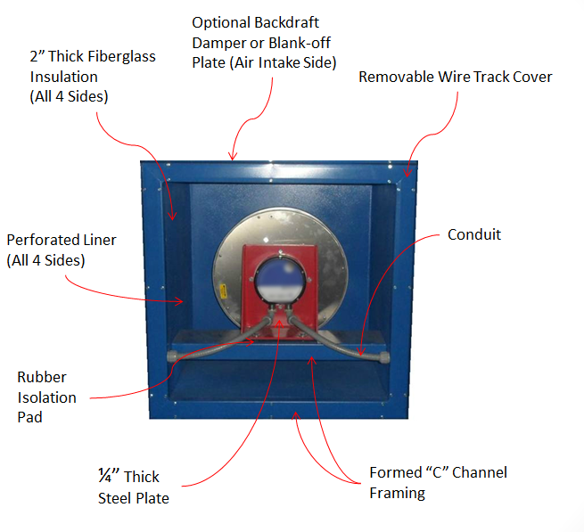
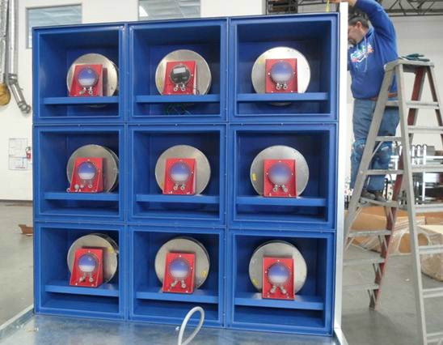
Multi Fan
DAT builds their own housing for each fan/motor using 12 gauge galvanized steel with a 22 gauge perforated liner covering a 2” thick fiberglass insulation.
Advantages
●Lower Power Consumption ● Noise Reduction ● Direct Drive ● Little to no vibration ●Light in weight ● Built in redundancy ● Easy to replace
Notes
The EC motors which DAT uses in their units have been tested to be more energy efficient.

Slide 16
Multi Fan cont.
DAT carries a variety of EC motors and fans. The following are general specifications of ECM capability.
Notes
There are many possible controls for the Multi Fan Unit.
Indicator lights can be programmed that will show which fans are running.
It is possible to set up the MFU so that a couple of the fans act as reserves and only go on in the case another fain fails.
The EC motors do not require VFD’s but rather a 4-20 mA or 0-10 DC signal.
Motor Size
0.5HP to 7.5HP
Wheel Size
10 inches to 25 inches
120 v. / 1ph. / 60Hz
Operating
Voltages
208-230v, 460v / 1ph. / 60 Hz 208-230v, 460v / 3ph. / 60 Hz

Slide 17
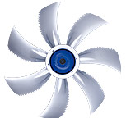
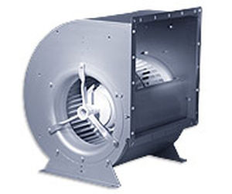
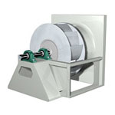
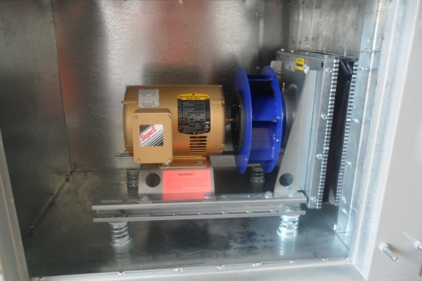
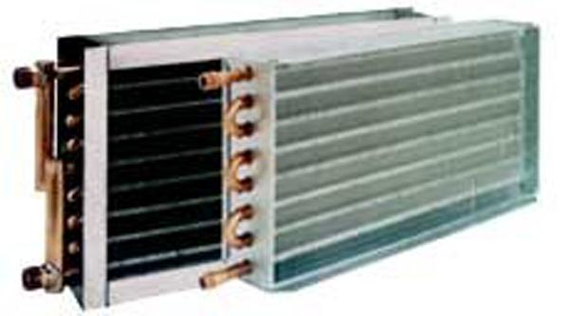
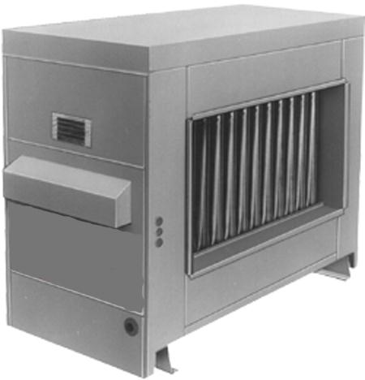
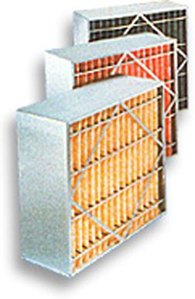
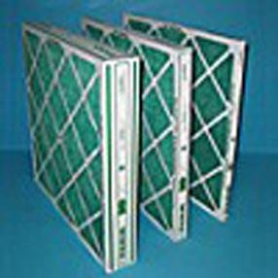
Internal components
Fans
Plenum (Belt & Direct Drive)
DWDI (Airfoil, Forward/Backward Curve
Propeller
Motors
ODP Premium
TEFC Premium
ECM
Cooling
Chilled Water Coil
Direct Expansion Coil
Direct Evaporative Cooling
Indirect Evaporative Cooling
Heating
Hot Water Coil
Steam Coil
Electric Heater
Direct Fired Gas Heaters
Indirect Fired Gas Heaters
Filters
2” Pleated 30%
4” Mini Pleated 65-95%
12” Rigid 65-95%
HEPA Filters 99.99%
Aluminum Washable

Slide 18
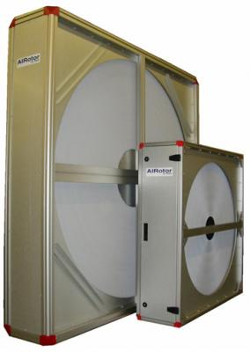
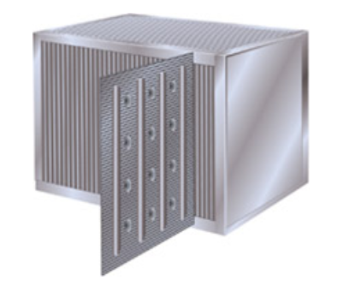
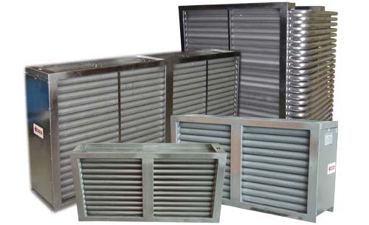
Energy Recovery components
The following are air-to-air energy recovery components that are commonly used in air handling units. Heat is transferred from one airstream to the other with little effort to further heat the supply airstream. This would save money in the long run because the heating component would not have to heat the air as much now that the entering air temperature into the heating device is hotter.
Wrap Around Heat Pipes
Heat Wheels
Plate Type Heat Exchanger

Slide 19
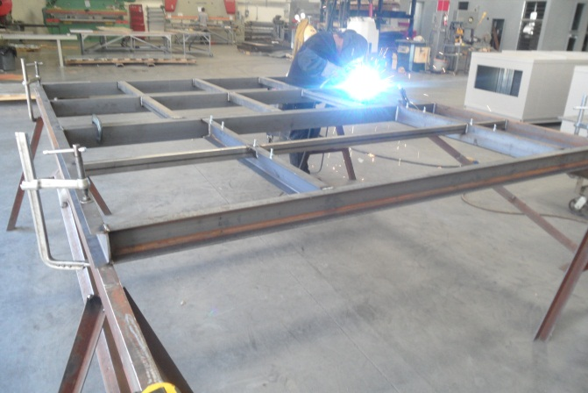
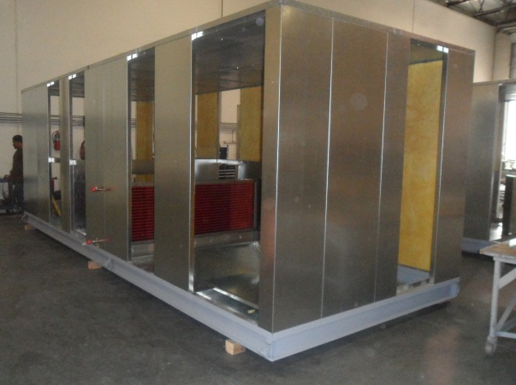
CONSTRUCTION
A standard 3”, 4”, or 6” structural steel channel base is used for outstanding support. In rare cases where a unit is very large and not divided into sections, an 8” or greater structural steel channel bases will be used. In cases where an engineer specifies something different, tubular steel or formed channels can be used.
DAT makes sure that each unit is built to last. Standard casing construction is G-90 galvanized steel. If required, the unit can be built using 304 or 316 type stainless steel or even aluminum.
For double wall construction, a solid or perforated liner will be used to cover up the insulation.

Slide 20
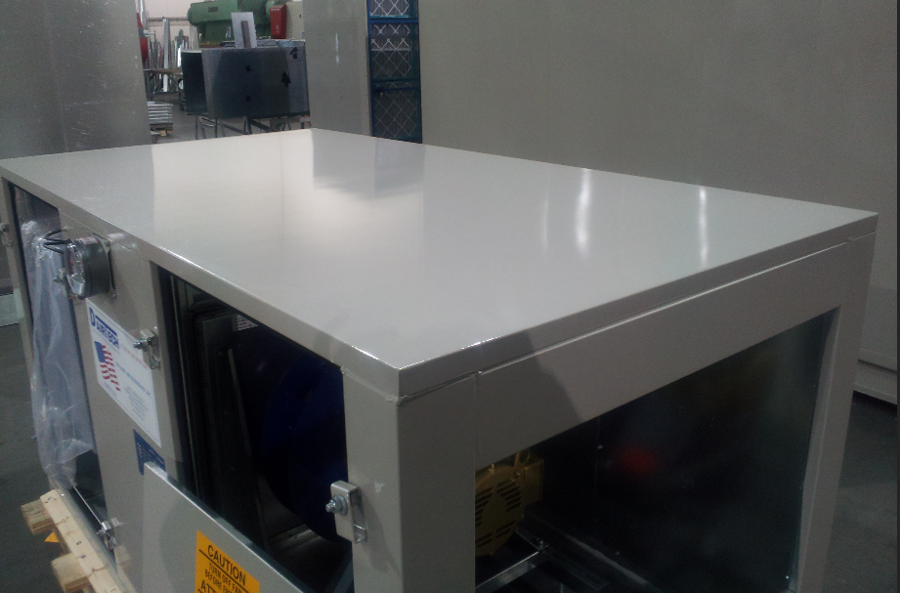
Outdoor/indoor roofs
Outdoor roofs are sloped so that water would slide off the unit.
The edges of the roof that overlap the side panels are bent outward so that water cannot seep inside.
Joint roof panels are attached with a metal sleeve
Silicone is then applied to the joining of panels to stop water from getting in and stop air from leaking out.
Indoor units have roofs that are typically flat.
Silicon is applied everywhere there is a joining of panels so to stop air from leaking out as well as stopping water from getting in incase of a wash-down.
Ceiling hung units would also have brackets with holes welded to the four corners of the roof so that it can be easily hung.

Slide 21
Unit material and thickness options
The following table shows the standard material and thickness for the main sections of an AHU that is used by DAT as well as available material and thickness.
 | Material | Standard Thickness | Material Type | Available Thickness | Available Material
Outer Wall | Galvanized | 18 ga. | G-90 sheet | 18 , 16 , 14 , 12 ga. | G-90 Sheet
 | Stainless Steel | 18 ga. | 304 sheet | 18 , 16 , 14 , 12 ga. | 304, 316 Sheet
 | Aluminum | 14 ga | Sheet | 14 , 12 , 10 ga. | Sheet
Wall Liner | Galvanized | 20 ga. | G-90 sheet | 22 , 20 , 18 , 16 ga. | G-90 Sheet/Perf
 | Stainless Steel | 20 ga. | 304 sheet | 22 , 20 , 18 , 16 ga. | 304, 316 Sheet/Perf
 | Aluminum | 20 ga. | Sheet | 22 , 20 , 18 , 16 ga. | Sheet/Perf
Floor | Galvanized | 16 ga. | G-90 sheet | 16 , 14, 12 ga. | G-90 Sheet/Plate
 | Stainless Steel | 16 ga. | 304 sheet | 16 , 14, 12 ga. | 304, 316 Sheet/Plate
 | Aluminum | 14 ga. | Sheet | 14 , 12 , 10 ga. | Sheet/Plate
Drain Pans | Galvanized | - | - | - | -
 | Stainless Steel | 16 ga. | 304 sheet | 16 , 14 , 12 , 10 ga. | 304, 316 Sheet
 | Aluminum | - | - | - | -

Slide 22
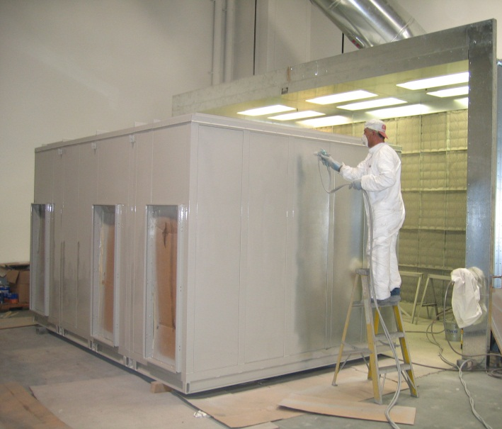
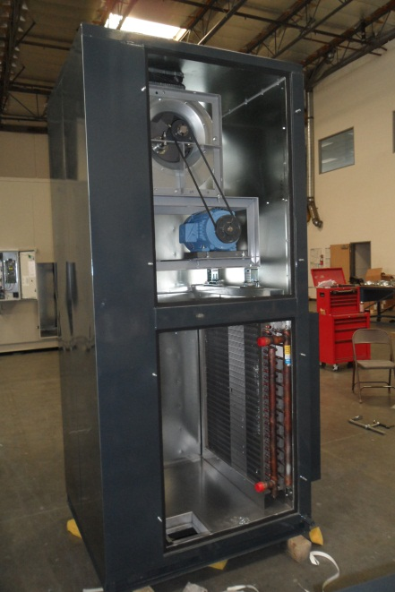
Paint
DAT uses a standard 1000 hour two component polyurethane paint.
An optional 5,500 hour paint can be used if needed.
For certain applications, an optional 8,000 hour primer can be applied prior to painting.
If the customer desires a different color than DAT’s standard Stone Gray, a paint chip can be provided where DAT will go ahead and get the paint mixed.

Slide 23
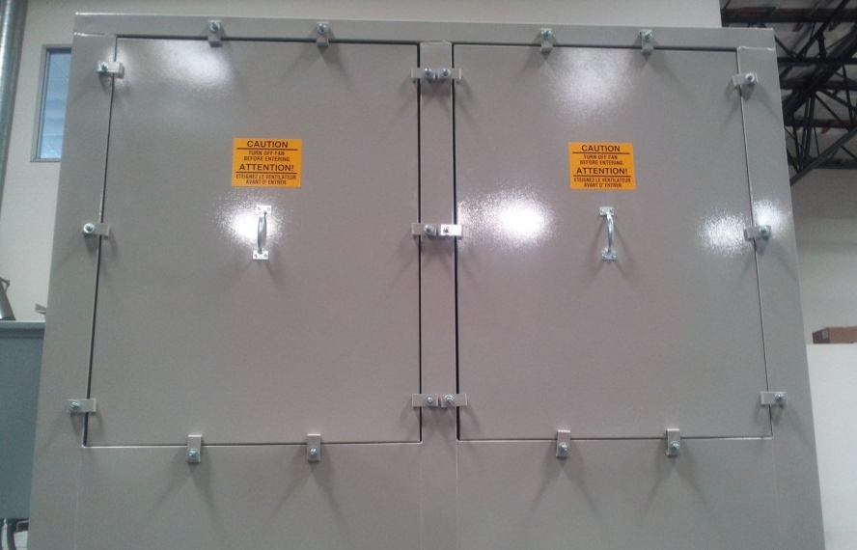
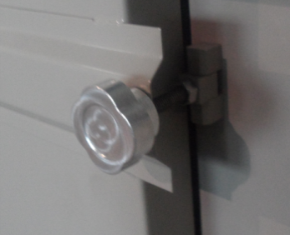
Access Doors
DAT Manufactured
DAT Door Hinge
DAT Access Panel
Door Knob
Fiberglass Insulation
Can be made entirely out of Aluminum, Galvanized, or S.S.
Constructed with adjustable hinges.
Knurled knobs used to open and close.
Optional window
Opens outward
Custom sizing possible
Great for smaller units and tight spaces.
Can be constructed in any material.
Available in any size.
Used typically when size is a factor or when a compartment does not need to be accessed frequently.

Slide 24
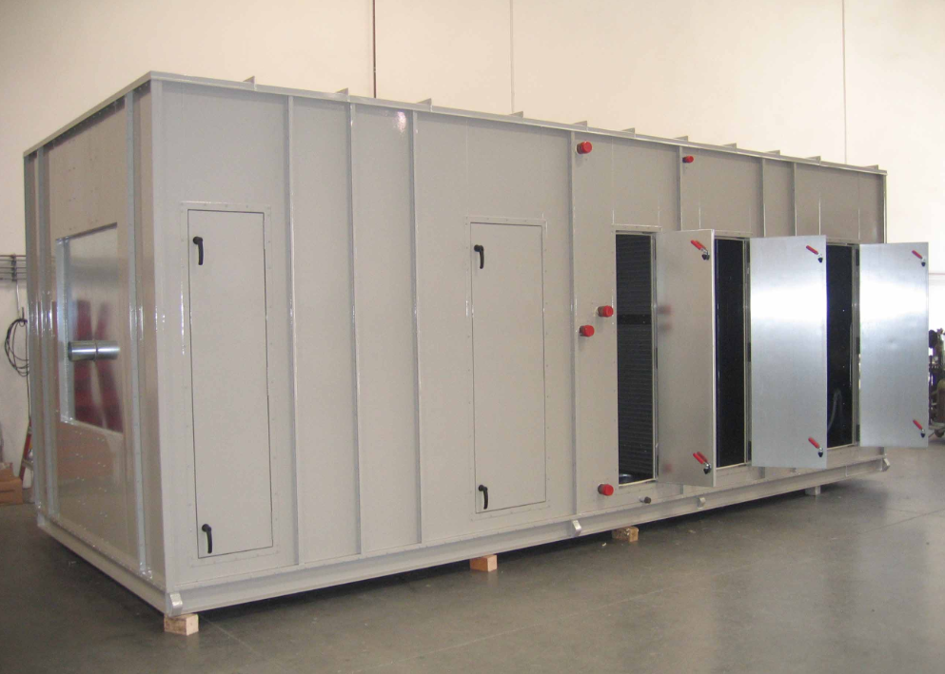
Access Doors
Flush with unit walls
Foam injected
Extruded Aluminum Frame
Galvanized or S.S. outside and liner.
Optional window
Opens inward/outward
Available only in standard sizes.

Slide 25
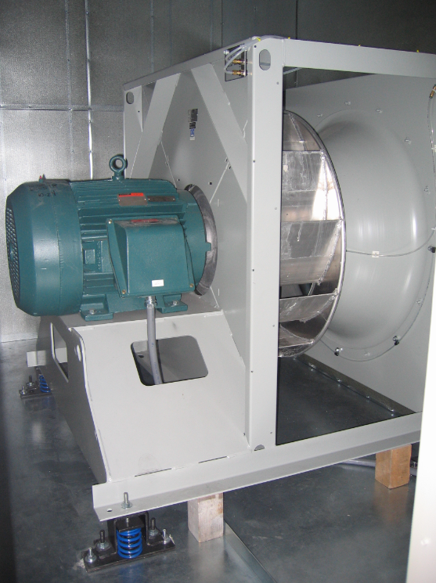
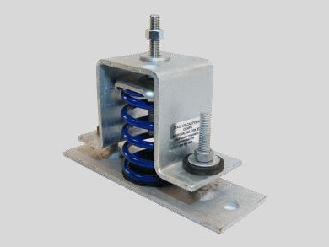
Large fan vibration isolators
DAT uses standard vibration isolators manufactured by CalDyn which are OSHPD certified.
Approximate weight calculations at different points of the motor/fan unit are calculated by DAT. A spring isolator is then chosen that would best suit the weights.
Typically, 4 isolators are enough to withstand the fan/motor in most cases. However, more would be needed for some of the larger units.

Slide 26
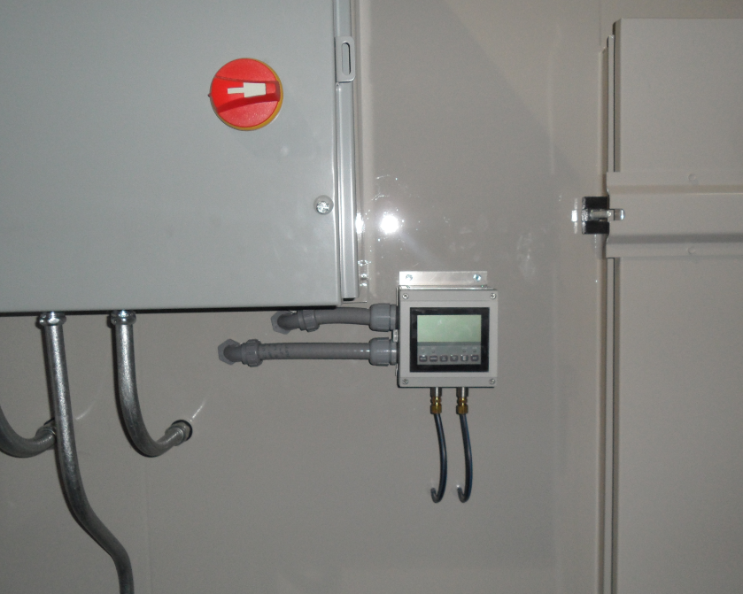
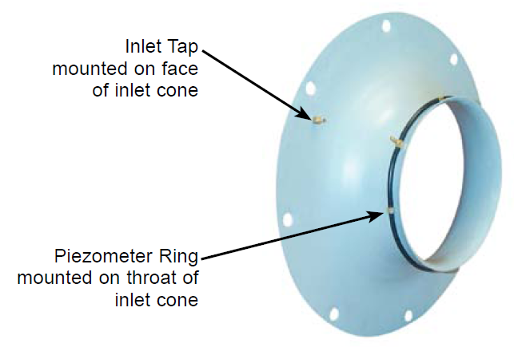
Air flow monitoring station
An optional air flow monitoring station can be installed on the unit. Fans have an option where the factory would install a piezometer ring along the cone of the fan. By doing this, it is possible to install a monitoring station so that it can read and display the static pressure or CFM of the fan. It will then transmit a signal back to the control room to give the status of the unit.

Slide 27
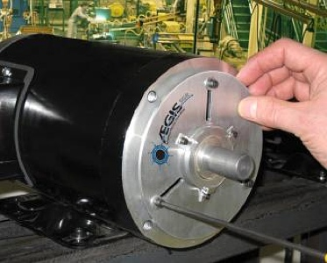
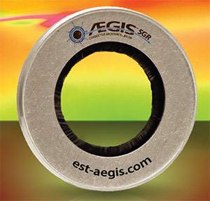
Shaft grounding
VFD induce voltage on the shafts of the motors that they control. This wears motor bearings and shortens the motor life expectancy.
DAT uses Aegis brand shaft grounding which provides protection against these problems by grounding the voltage.

Slide 28
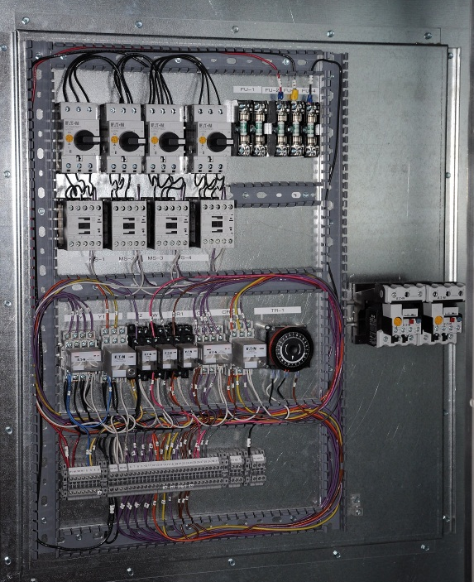
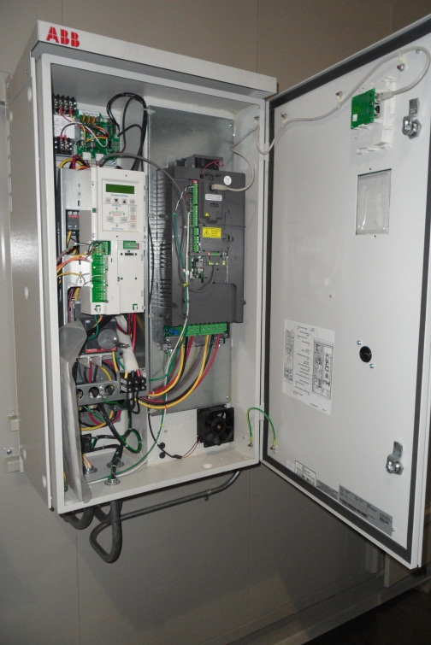
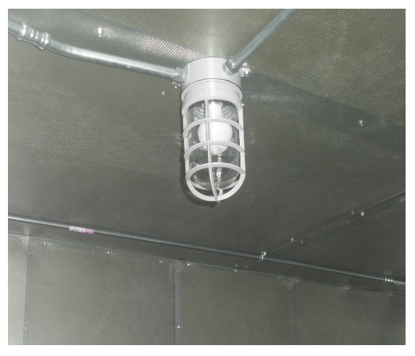
Electrical Components
DAT is able to wire any components the customer would like to have in their unit.
Pressure/CFM meters
VFD (ABB, CERUS, etc.)
Motor Protection
Disconnect Switch
Damper Actuators
Single Point Power Connection
Control Relays
Step-down Transformers
Fan Indicator Lights
GFI Outlets
Unit Lighting

Slide 29
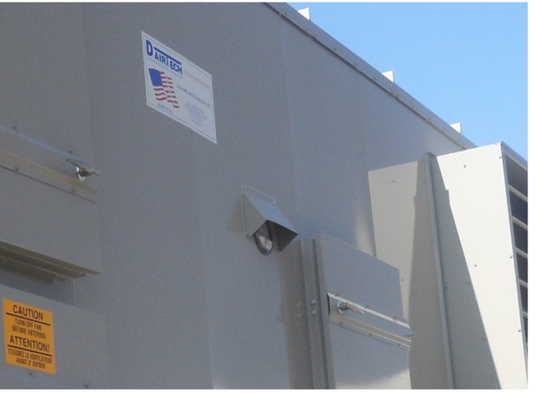
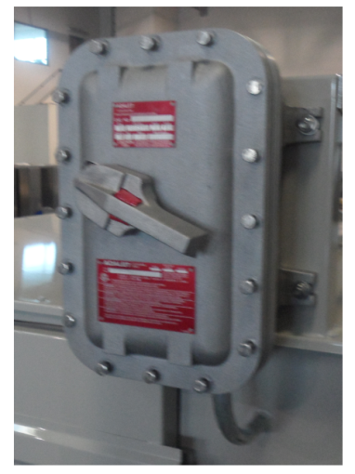
Electrical Components
DAT is capable of installing and wiring electrical components in conditional enclosures.
Wiring of the electrical components can be housed in weatherproof
DAT constructed enclosures.
NEMA 3R enclosures.
NEMA 4 enclosures.
Explosion proof enclosures.
etc.

Slide 30
Calculating MCA & MOP
Most contractors will at a point in time of design require the Minimum Circuit Ampacity (MCA) and/or the Maximum Over-current Protection (MOP) of a unit. While DAT will gladly calculate these numbers for the customer, it is good to understand where these numbers are coming from.
Calculating MCA
In units with only motors.
MCA = (1.25 x Load1) + (Load2)
In units with motors, electrical heaters and other loads over 1.0 A (no compressors).
MCA = (1.25 x Load1) + Load2 + Load3 + Load4
In units with motors, compressors, electrical heaters, and other loads over 1.0 A.
MCA = (1.25 x Load1) + (1.25 x Load3) + Load2 + Load4
Calculating MOP
MOP = (2.25 x Load1) + (Load2 + Load3 + Load4)
Load1 = current of largest motor
Load2 = sum of currents of all other motors
Load3 = current of electric heater
Load4 = current of any other load over 1.0A

Slide 31
Shipping
In most cases, DAT includes the shipping cost in the pricing that is provided because customers would like to have DAT take care of shipping headaches. Shipping companies that are used by DAT have a long work relationship with DAT and know how to properly take care of the units.
Sometimes, the customer may find shipping the units themselves much simpler. In this case, the customer is to call DAT and schedule a pick-up.

Slide 32
Shipping Limitations
FLATBED
Maximum Unit Height | 8' 6" (102")
Regular Unit Width | < 8'6" (102")
Wide Load | > 8'6“ (102") & < 12'0" (144")
Pilot Cars Required | > 12'0" (144")
Drop Deck
Maximum Unit Height | 10' 3" (123")
Regular Unit Width | < 8'6" (102")
Wide Load | > 8'6“ (102") & < 12'0" (144")
Pilot Cars Required | > 12'0" (144")
Double Drop
Maximum Unit Height | 11' 6" (138")
Regular Unit Width | < 8'6" (102")
Wide Load | > 8'6“ (102") & < 12'0" (144")
Pilot Cars Required | > 12'0" (144")
Max Section Length | ~ 29' (348")

Slide 33
Splitting Units Into Sections
DAT divides their units based on several factors. These include, but are not limited to,
Shipping
If a unit is too wide or tall to be shipped, the unit will be divided to be within standard shipping dimensions
Weight
Sometimes a crane operating a unit cannot handle the weight of the unit and so it would be split into sections that comply with the limitations
Space
Sometimes the location of units must be guided through small openings. If this is the case, the units can be broken down to small enough pieces to fit properly.
Assembling The Units
The units will be shipped with all necessary hardware and instructions on how to put the sections together.

Slide 34
Reattaching Split Units
The following are instructions to assembling the split the units at its final location.
Remove plywood covering section openings by removing the screws holding them up.
Some sections might be covered in plywood during shipping to protect internal components.
Apply the provided gasket around the perimeter of ONE of the sections where the two sections will meet.
This helps prevent air from leaking out when the sections are put together.
Bring the sections together and fasten them with the nuts and bolts provided.
Each section will be marked with stickers to show which sections are joined together.
The tabs with holes along the sides of the sections (circled in red on the left) have holes that will align with the conjoined section. This is where the bolts are placed.
After tightening the bolts, apply caulking at the seams both inside and outside.
Caulking will be provided and further stops air from leaking.
Place the metal strips over the seams and fasten them onto the unit with the provided self-tapping screws

Slide 35
Reattaching electrical components
In the case of a split unit where DAT is responsible for the wiring, DAT wires the unit entirely as if it were a single piece then disassembles whatever wire/tubes that are needed to split the unit.
When there are wires inside the sections that need to be disassembled, the conduit from one section is taken out and placed in the adjacent section. The conduit and all the wires are clearly marked with labels to show where each wire must go.
When there are wires outside the sections that need to be disassembled, the tubes that interfere are taken out and shipped separately. The wires are once again labeled and hung next to the tube that it must enter. A frontal picture of the unit is provided with the unit that has numberings on the picture that corresponds to the numbering on the tubes so that the contractor can simply put it together.

Slide 36
Services
Services that can provide for engineers are
Drawings of the unit .pdf and in Autocad
Electrical diagram
Approximate weight
Fan selections/curves
Coil selections
Indirect/Direct performances
Sound Performance
Price
Services that can provide to make sure the job goes well.
DAT can go to the existing job site to measure existing units/roof curbs to make sure what is to be built goes as smoothly as possible.
DAT can work with engineers during the design stage to ensure all the customer’s needs are fulfilled.

Slide 37
Leak & Deflection Testing
If needed by the customer, DAT can schedule leak and deflection tests for their unit. The following are test results of previously tested units.

Slide 38
Solutions to common problems
Weight issues?
DAT can build all aluminum units reducing the weight of a regularly built unit by up to 60% all while keeping strong support and durability.
Corrosion problems?
Units can be built using 304 or 316 type stainless steel to provide the best corrosion resistance.
Unit too large to move in place or ship?
Sometimes desired units are either too big to be lifted or too big to be shipped. Therefore, these units are shipped in sections and simply put together at the job site.
Tight spaces?
These are common in historical buildings where nothing can be torn apart. In these cases, DAT builds the units fully, disassembles them at the job site, and then reassembles them at the desired location.
Prefer a specific component manufacturer?
DAT can use any specific component manufacturer the customer prefers such as fans, coils, dampers, filters, etc.
Need a new section on an existing unit?
DAT can build can build the section you require in such a way that it would work with your existing unit. This application would be most common in the motor/fan section by replacing the current motor/fan with the multi fan technology
Replacing an existing unit but want to keep the roof curb?
No problem! DAT is known to go to the job site and measure exactly what is needed so that the built unit sits perfectly on top of the existing roof curb.
Have a budget?
Let the sales team know. DAT will give you some alternate options that would cut on costs and give you a budget price for those units.
Need it fast?
One of the thing that makes DAT so popular is the lead time. Expediting options are available. Contact DAT to see what can be done.

